Slide 1
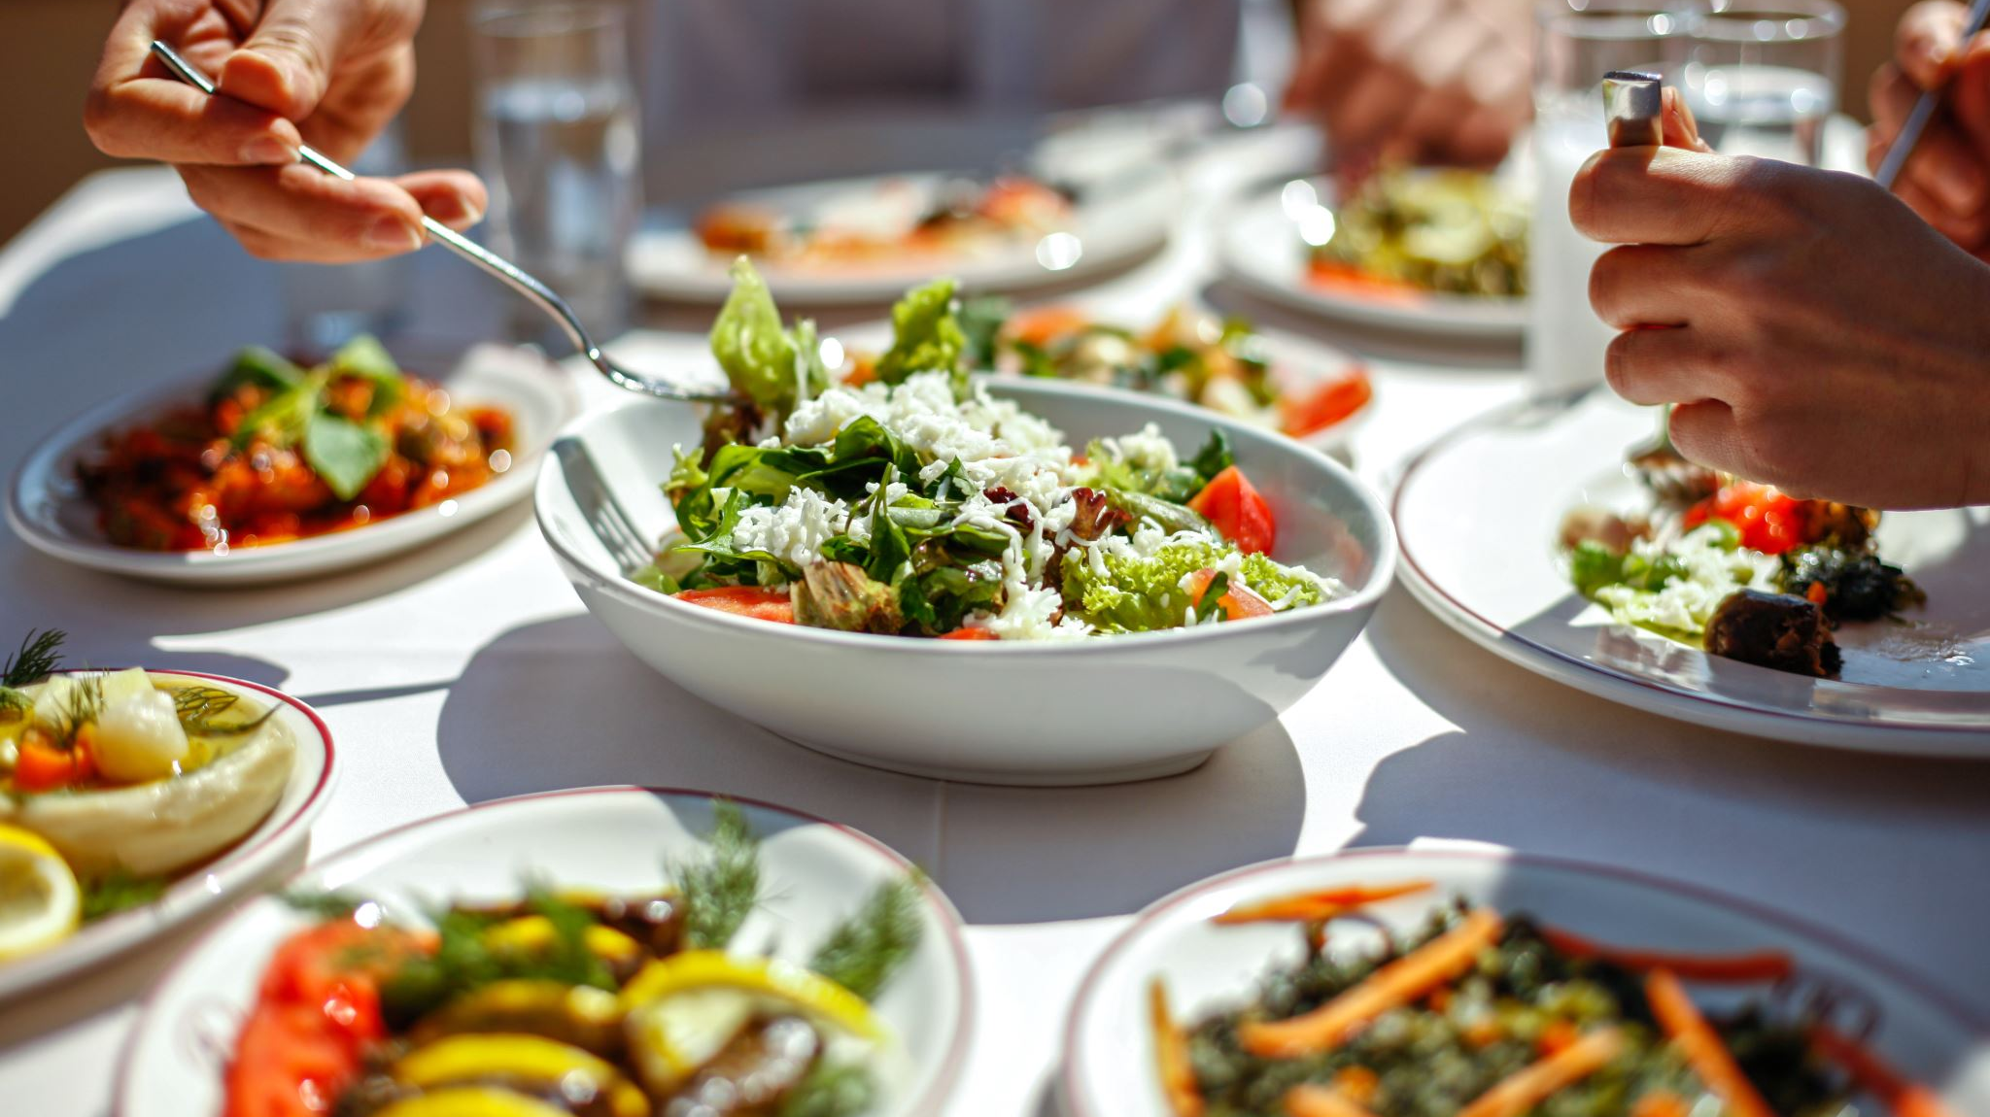
Food stylists

Slide 2
Learning Intentions and success criteria
Learning Intentions:
We will learn what the role of a food stylist is.
We will learn how images of food are a persuasive marketing tool in the industry.
Success Criteria:
I am able to identify what the role of a food stylist is.
I can effectively explain how images of food are a persuasive marketing tool in the industry.

Slide 3
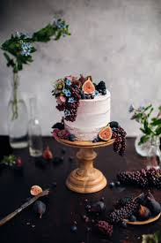
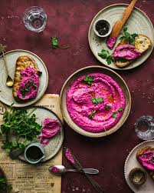
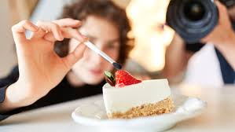
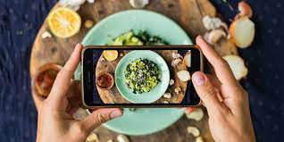
What is the role of a food stylist?
A food stylist is a person who prepares food for photographs or television.
They will often work closely with chefs, editors and photographers.
Food stylists usually prepare dishes and use styling techniques so food looks great and lasts for the length of the photoshoot.

Slide 4
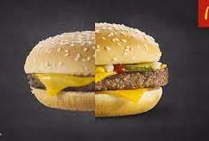
Activity 1
we are going to explore how images of food are a persuasive marketing tool and then identify how this often differs from the reality of the food.
we will compare some real life examples and watch a video on food styling.
https://www.bayvista.com.au/gallery/
https://www.tripadvisor.com.au/Restaurant_Review-g552085-d722248-Reviews-Bay_Vista_Dessert_Bar_Cafe-Brighton_le_Sands_Rockdale_Greater_Sydney_New_South_Wal.html

Slide 5
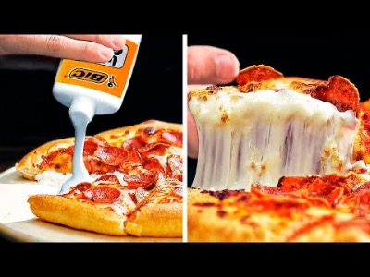
https://www.youtube.com/watch?v=9k7PJoNAXkk

Slide 6
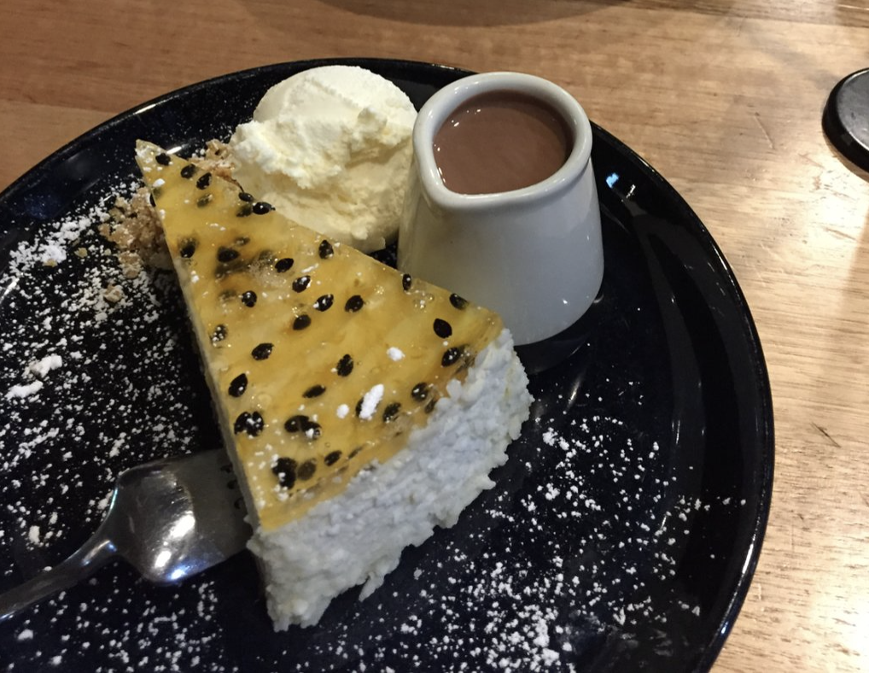
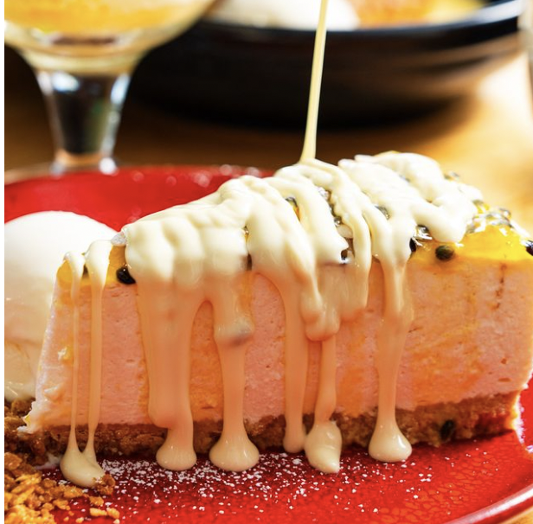
e.G Bay vista
Real life
Bay Vista marketing

Slide 7
Activity 2
With the person or people next to you, Students are to conduct research and create a presentation that outlines different tricks and techniques used by food stylists

